Slide 1
Exploratory Data analysis - Retail
Rashmi S
GRIP Internship

Slide 2



agenda
Introduction​
Primary goals​
Inferences
Areas of growth​
Summary​

Slide 3



Introduction
Sample Superstore dataset of a retail company was taken into play to analyse and make fruitful insights about the functioning of the superstore. To find the areas of development and make insightful decisions for the growth and profit of the company in the future.

Slide 4


Primary goals
Click to add photo
Annual Revenue Growth
Increasing Sales
Boost Production
Maximize Profit

Slide 5
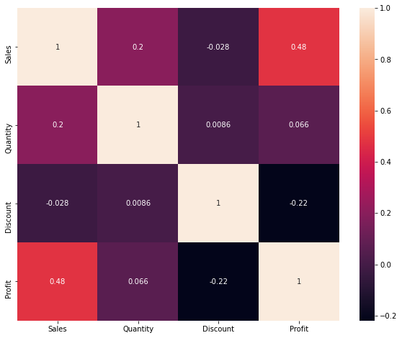
Correlation matrix
We observe a negative correlation between Discount and Profit
We observe positive correlation between Sales and Profit, hence the company is in good terms with regards to revenue
There exists a negative correlation between Discount and Sales, so ideally no use discounts

Slide 6
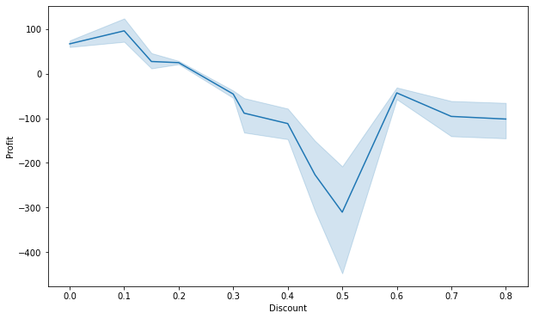
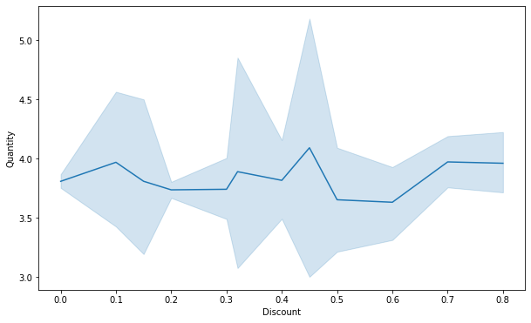
Do we really need discounts ?
The profit is observed to be extremely low when a discount of 50% is introduced in the market
The company is making good profit when a discount of about 10% is introduced
Though the profit during 50% sales period is less, the amount of goods bought is comparatively higher.

Slide 7
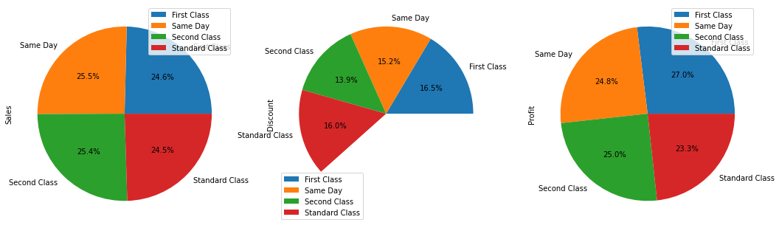
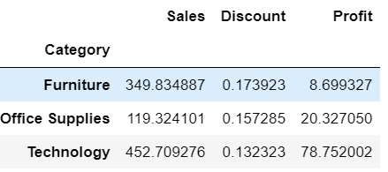
as quicker the better ?
1) Same Day Shipment has the highest sales.
2) First Class Ship mode has the highest Profit and Discount
3) Standard Class Ship mode has lowest sales.
4) Standard Class Ship mode has lowest profit.

Slide 8
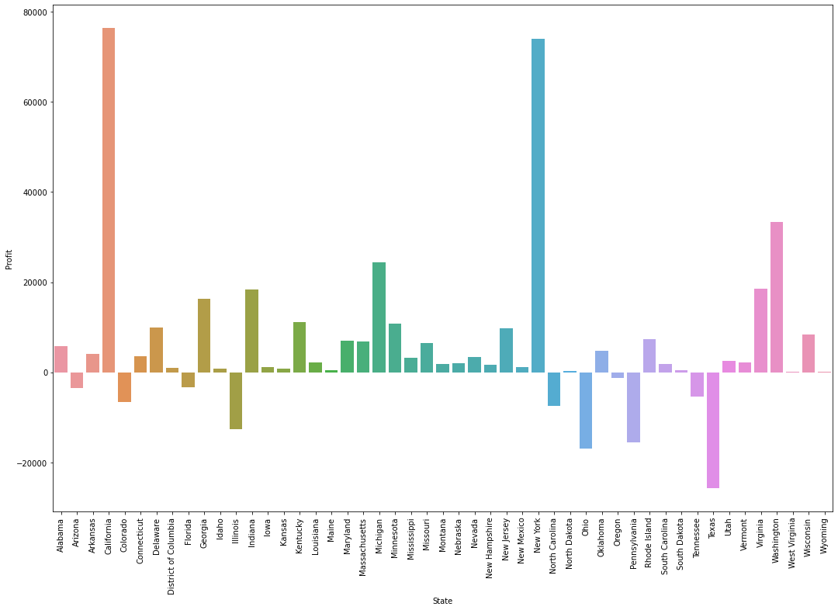
Targeted states !
'California’ makes highest profit henceforth the price margin in this region to be increased inorder to increase sales
Lowest profit is shown by 'Texas’ henceforth a lot of ground work to be done
Top 4 profit giving states: 'California’, 'New York’, 'Washington’ and'Michigan’
Bottom 4 loss giving states: 'Illinois’, 'Pennsylvania’, 'Ohio'and'Texas'

Slide 9
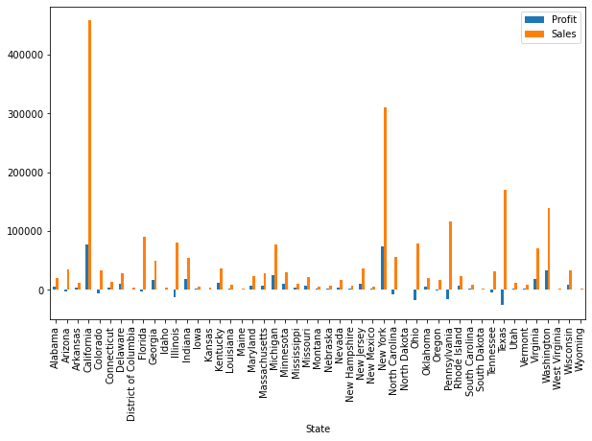
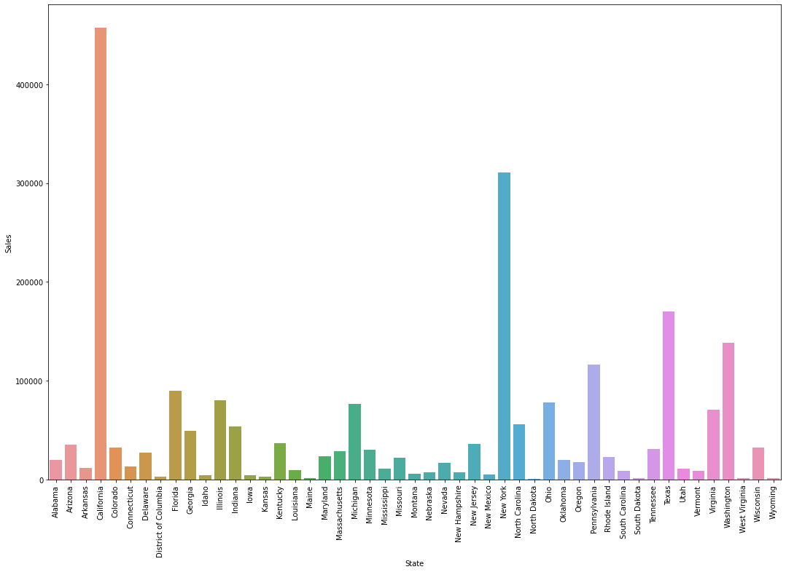
Profit v/s loss
Highest sales is shown by 'California'
Top 4 States with highest Sales : 'California','New York','Texas'and 'Washington'
Top 4 states with lowest Sales:'North Dakota’, 'Maine','West Virginia'and'South Dakota'
Thus, Texus has high sales but low profit
The Non profitable states are Texas, Pennsylvania, and Ohio

Slide 10
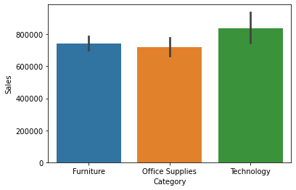
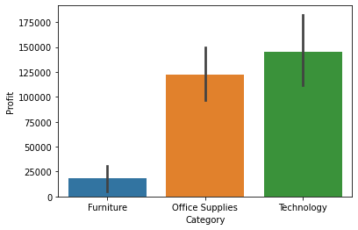
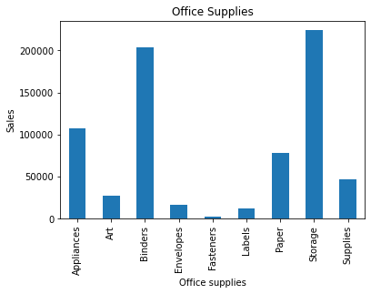
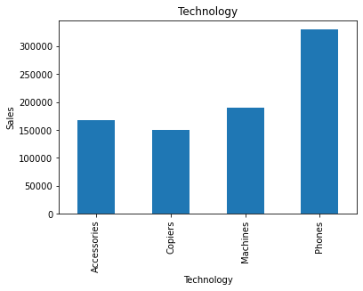
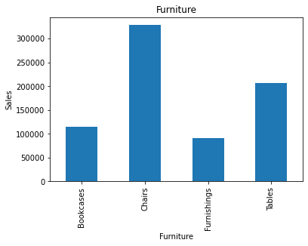
Product production !
Technology makes most of the sales
Under Furniture Chairs make most of the sales
Under Office Supplies Storage and Binders make most of the sales
Under Technology category Phones make the highest sales

Slide 11
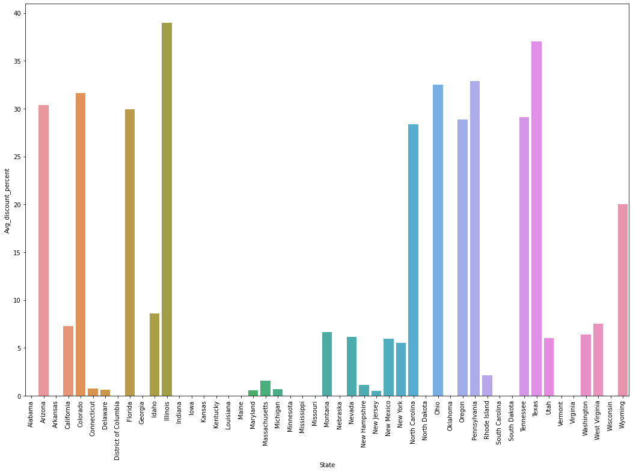
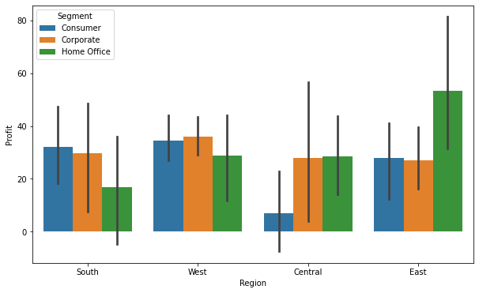
Let’s dive in?
Illinois has highest avg_discount percent in USA
49 states have zero avg discount, this must be increased to other states
Highest profit making categories at different regions
South = consumer segment
West = Corporate segment
Central= Home office segment
East = Home office segment

Slide 12

Areas of growth
Discount has not effect on Quantity sold
Same Day shipment mode performance to be improved
Loss in Texas, Ohio and Pennslvania to be addressed
Profit and sales are not related
Sales of Office supplies to be increased
Improvements needed in southern Region

Slide 13

Business opportunities are like buses. There's always another one coming.​
Richard Branson

Slide 14
Plan for product launch
1
Planning
4
Strategy
Synergize scalable e-commerce
Foster holistically superior methodologies
2
Marketing
5
Design
Disseminate standardized metrics
Coordinate e-business applications
3
Launch
Deploy strategic networks with compelling e-business needs

Slide 15
Areas of focus
B2B market scenarios​
Cloud-based opportunities​
Develop winning strategies to keep ahead of the competition​
Capitalize on low hanging products to maximize sales
Understand Customer’s​
Iterative approaches to corporate strategy​
Establish a management framework from the inside​
Increase Advertisements

Slide 16
Summary
Top 4 profit giving states: 'California’, 'New York’, 'Washington' and 'Michigan'. We can increase sales in these states for increasing profit. Also minimize the discounts in these regions
Top 4 loss giving states: 'Illinois’, 'Pennsylvania’, 'Ohio' and 'Texas'. We have to pay attention to these states for reducing the loss and making these states on a positive cash flow.
Texas, Pennsylvania, and Ohio have high Sales but negative Profit i.e. loss. This is because of the high discounts given to customer. We need to decrease discount percentage at Texas, Pennsylvania, and Ohio.
Illinois has the highest Avg discount percent among the states of USA but profit and sales are low here. So we can reduce discount % in Illinois
In the Southern Region customer segment profits must be increase as this category is performing well at other regions, understanding the sales force and mindset and geographical conditions might seem to be a great idea
Technology Category has the maximum Sales and Profit. Increasing variability of products in this region would be ideal
Furniture category has good sales but low profit. The profit margin should be increased
Same Day Ship Mode has the highest sales and First Class Ship mode has the highest Profit and Discount. So, we have to use Same Day Ship Mode and First Class Ship in greater frequency by creating Advertisements

Slide 17

Thank you
Rashmi S
Sparks Foundation
https://internship.thesparksfoundation.info
Dataset used
https://bit.ly/3i4rbWl

